Slide 1
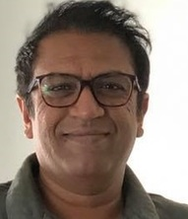

MSE-BioMC Invited Talk
Prof. Shahriar Hossain
University of Queensland
School of Mechanical and Mining Engineering
Topic: Materials Space-Tectonics: A New Paradigm for Designing Next-Generation Nanoporous Materials for Energy and Biomedical Applications
November 25, 11AM-12PM
Lassonde Mining Building (MB)
Room 101

